Slide 1


Damage Prevention Training 2020
Excavator Safety
By: New Jersey Utilities

Slide 2
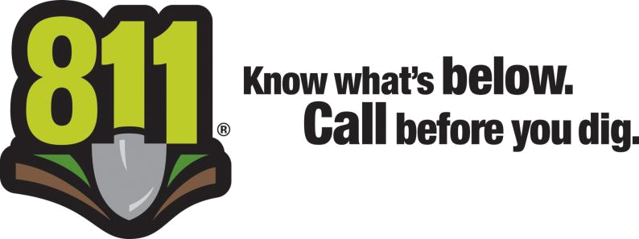
Mission
Our mission is to promote education and awareness and foster a partnership with all of you to help protect our infrastructure, your companies and our communities.
It’s the Law!

Slide 3
It’s The Law & It’s Free!
In New Jersey it’s illegal to dig anywhere in the state without first calling for a markout.
Calling 811 or 1-800-272-1000 gets your utility lines marked and helps protect you from potential injury and unnecessary expense.
It’s the Law!

Slide 4
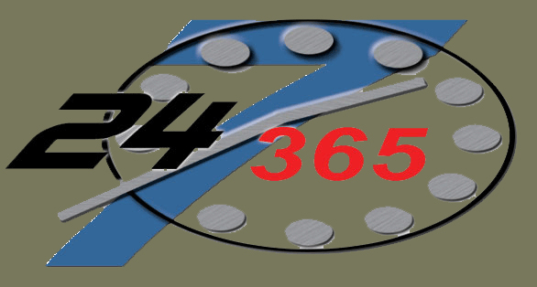
Hours for the NJ One Call Center
Contact the NJ One Call Center
7 days a week, 24 hours a day,
any day of the year.
One Call:
811 or 800-272-1000
ITIC & Fax
www.nj1-call.org

Slide 5

Who Should Call the NJ One Call Center?
"Excavate" or "excavation" or "demolition" means any operation in which earth, rock or other material in the ground is moved, removed or otherwise displaced by means of any tools, equipment or explosive
Up to and Including:
Planting a Tree
Mailbox
Fencing & Dog Fence
Sidewalks, Curbs
Moving Dirt
Pest Control
Sprinkler
Stump Removal
Roadway Signs/Real Estate Signs
Excavation
Demolition
Road Milling/Paving
Paving
Driveways
Drainage
Sewer or Water
Utility

Slide 6
Ways to Call in or Process
Markout Requests
Call 811 or 1-800-272-1000
  Speak directly with a customer service representative
Remote Entry (ITIC)
  Your company can enter their request using the web service known as ITIC (for “Internet Ticketing”). User will have a secure login using their email address, pass code and training. Please e-mail them at NewJerseyITIC@occinc.com for your pass code.
Fax
  Using the New Jersey One Call form. See fax locate agreement form and fax form that must be used to submit your request on web site at www.nj1-call.org

Slide 7
What Type of Ticket Does the
NJ One Call Center Process?
Routine:
  Must wait 3 business days for a markout. Begin digging within 10 business days. Tickets expires in 45 business days.
Update:
  Reason to update your routine ticket, mismarked & not marked Underground Facilities.
Emergency:
  Any condition constituting a clear and present danger to life, health or property caused by the escape of any material or substance transported by means of an underground facility or interruption of a vital communication or public service that requires immediate action.
Notes:
Presenter should talk about the incentives to using ITIC including the ease of use and time saved.

Slide 8
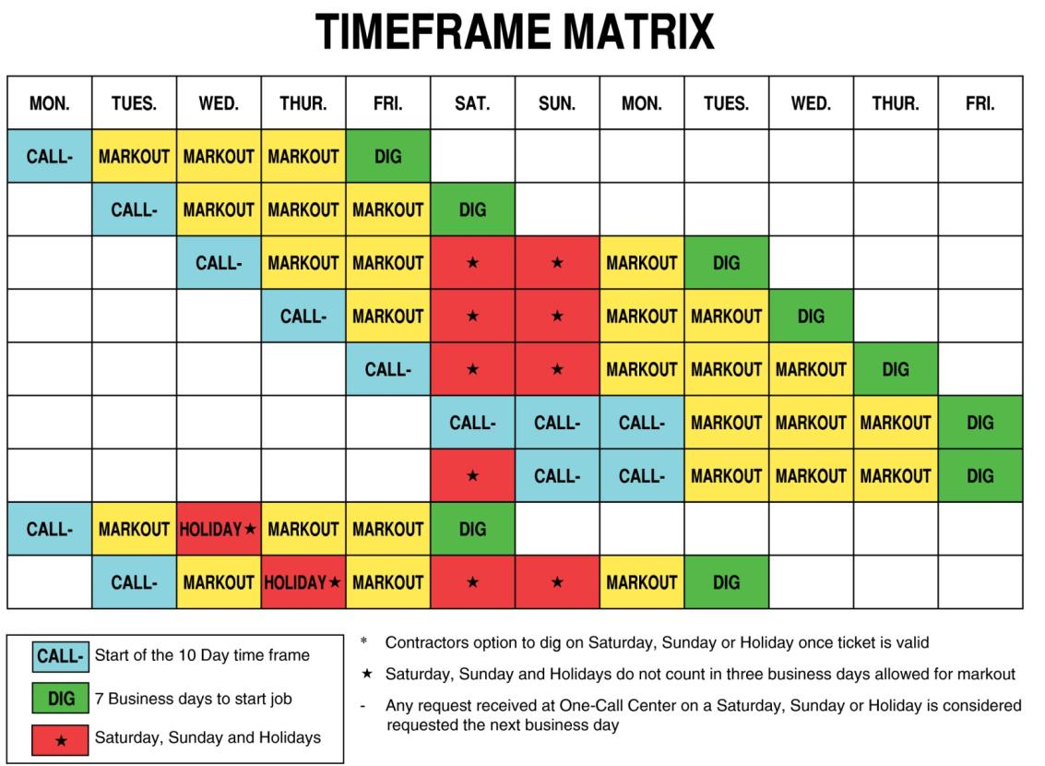
New Jersey
State Holidays
New Year's Day
Martin Luther King Jr.
President's Day
Good Friday
Memorial Day
Independence Day
Labor Day
Columbus Day
Election Day
Veteran's Day
Thanksgiving Day
Christmas Day

Slide 9

Before Contacting the NJ One Call Center:
County
Municipality
Address
Nearest Intersection
Other Intersection
Type of Work
Extent of Work
White Painted Area
Who are you working for
Excavator or Homeowners Information

Slide 10
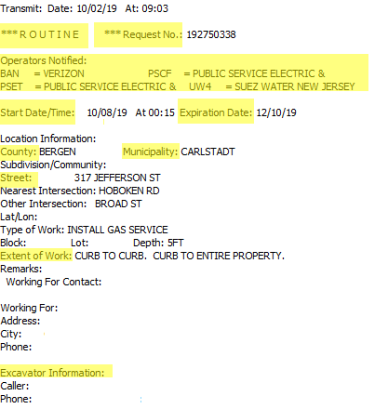
NJ One Call Markout
Ticket

Slide 11
Positive Response
Once the facility operator or locating company, performs the locate, you will receive a positive response providing an email or fax have been given during the initial call, letting you know the facility is marked or cleared. Remember you still will not be able to dig until your start dig date.
Ticket Number: 192750338
Location: 317 JEFFERSON STREET, CARLSTADT, NJ
As of 10/04/19 14:54 EST, participating facility owners have responded to Ticket Check as follows:
District Code Status
VERIZON Clear/No conflict
PUBLIC SERVICE ELECTRIC & GAS Marked
TOWNSHIP OF CARLSTADT Does not participate in Ticket Check, please call (555)451-9405 for more information

Slide 12
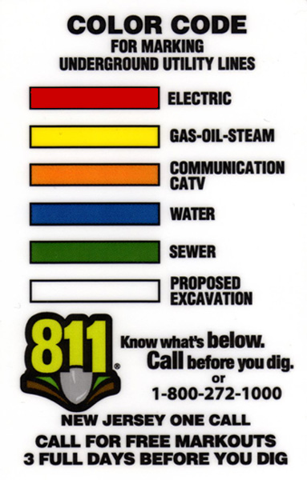
What Do the Colors Mean?

Slide 13
Things to Know:
Call 3 business days ahead, but not more than
10 business days
All excavators must have their own markout request
Must provide physical location of dig site – not postal address
Excavators must verify their location, dig date and have copy of request (ticket) on site
Excavation must begin 10 business days or request (ticket) is no longer valid
Excavator must protect and preserve marks until no longer necessary

Slide 14
Things to Know:
Plan the excavation or demolition with reasonable care to avoid damages
Support and protect facilities from traffic and other hazards
Request (ticket) expires in 45 business days
If your project will extend past 45 business days you must call for a new markout for the project to continue

Slide 15
QUIZ!
How many days after calling 811 to request a utility markout can you start digging?
  3 BUSINESS Days
If I see marks on the ground do I still need to call 811?
  Yes, all excavators need their own VALID markout request.
What color are the electric markouts?
  Red

Slide 16
Who Marks the Lines?
The utility companies are responsible to mark out their facilities or lines
Often they will hire a third party to do their markouts
Privately owned facilities (after the meter) are the responsibility of the property owner

Slide 17
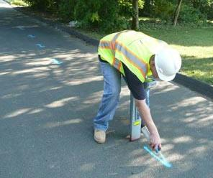
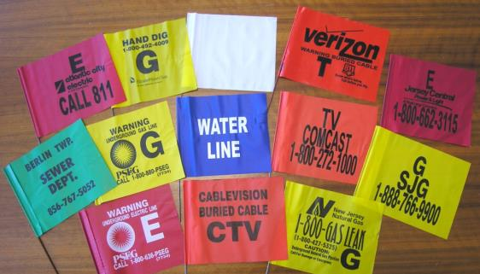
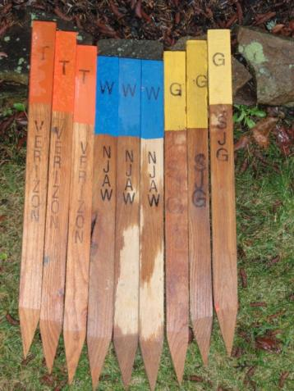

How Lines are Marked
1. Paint
2.Flags
4.Stakes
3. Whiskers

Slide 18
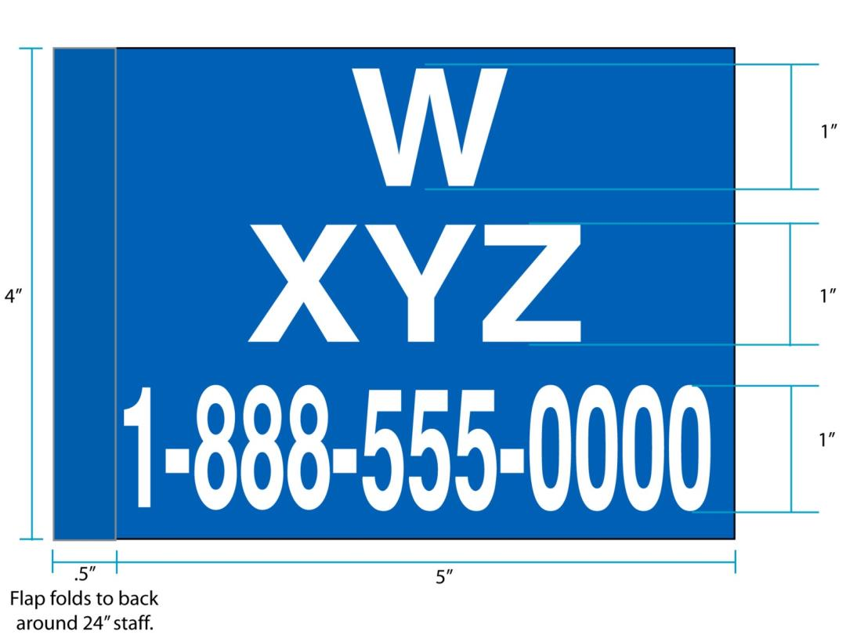
Flag Standards N.J.A.C. 14.2-5.2

Slide 19
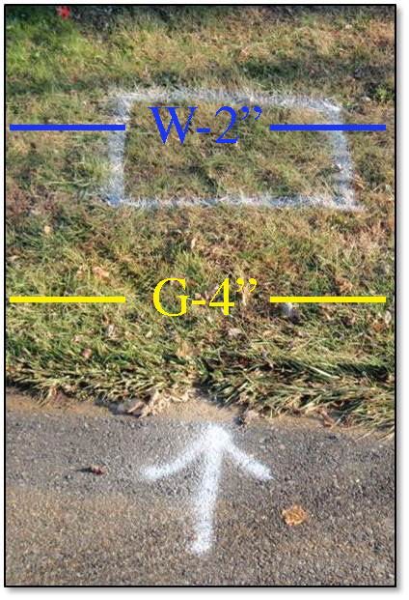

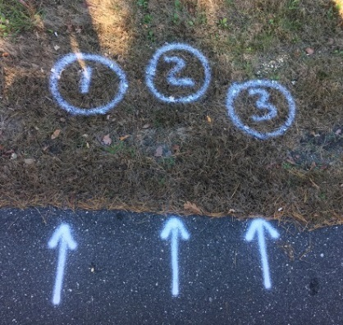
White Paint Area
N.J.S.A. 14:2-3.2 Notice of intent to excavate – contents, perimeter marking
(c) Where appropriate to clearly identify the site of a planned excavation or demolition, an excavator or responsible contractor may choose to mark the perimeter of the site in white, prior to notifying the One Call Center. White perimeter marking is encouraged in order to minimize unnecessary marking and locating by the underground facility operators.
For example – use marking to indicate small sites, nonlinear excavations, and spot excavations such as a soil borings, mailboxes, sign posts, or tree planting.

Slide 20
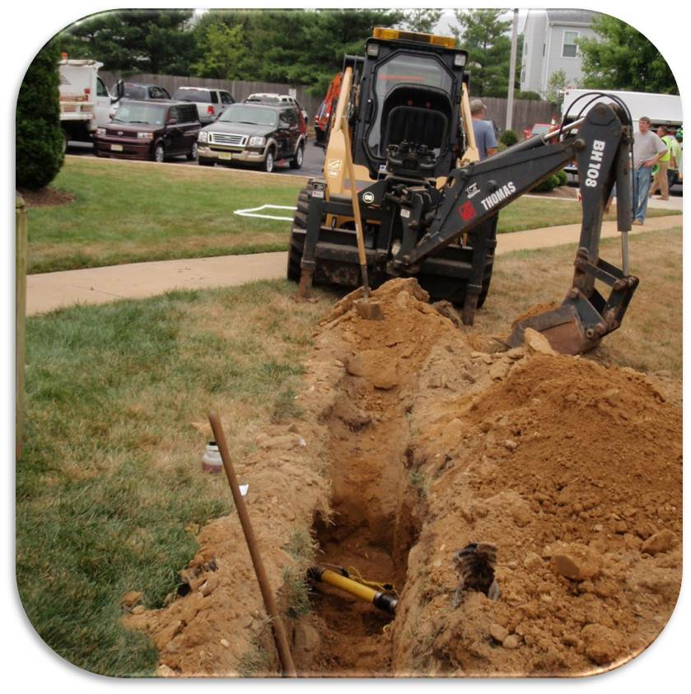
Perimeter

Slide 21
Unmarked Lines
What should I do if there are visible signs that a utility is in my work area and it was not marked?
    Call the NJ One Call Center with your original ticket number and advise the customer service representative of the company that did not mark out.

Slide 22
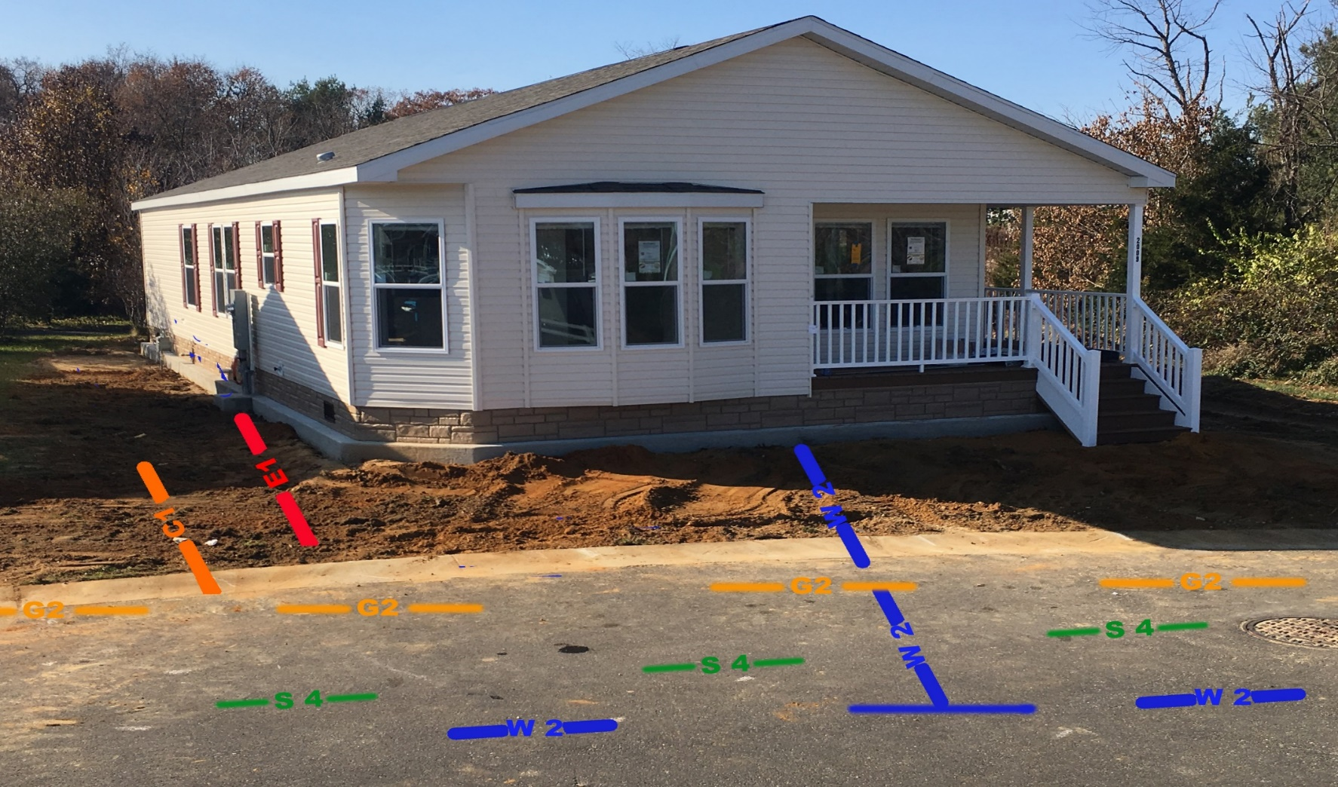
What’s Missing?
Ticket for curb to curb and curb to entire property
Communication Service is Marked but the Communication Primary is missing
Natural Gas Main is Marked but the Gas Service is missing
Electric Service is Marked but the Electric Primary is missing
Sewer is marked in the street but not going up to the house

Slide 23
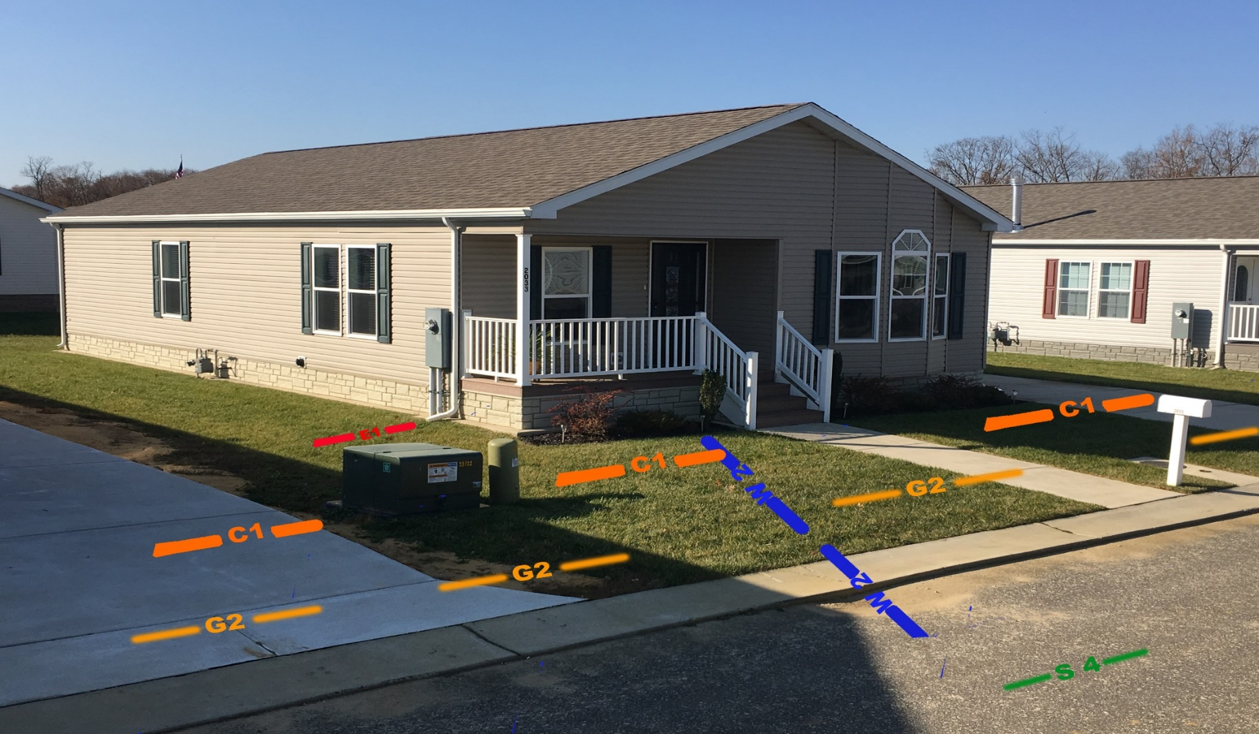
What’s Missing?
Ticket for curb to curb and curb to entire property
Communication Primary is Marked but the Communication Service is missing
Electric Service is Marked but the Electric Primary is missing
Natural Gas Main is Marked but the Gas Service is missing
Water Service is Marked but the Water Main is missing
Sewer is marked in the street but not going up to the house

Slide 24
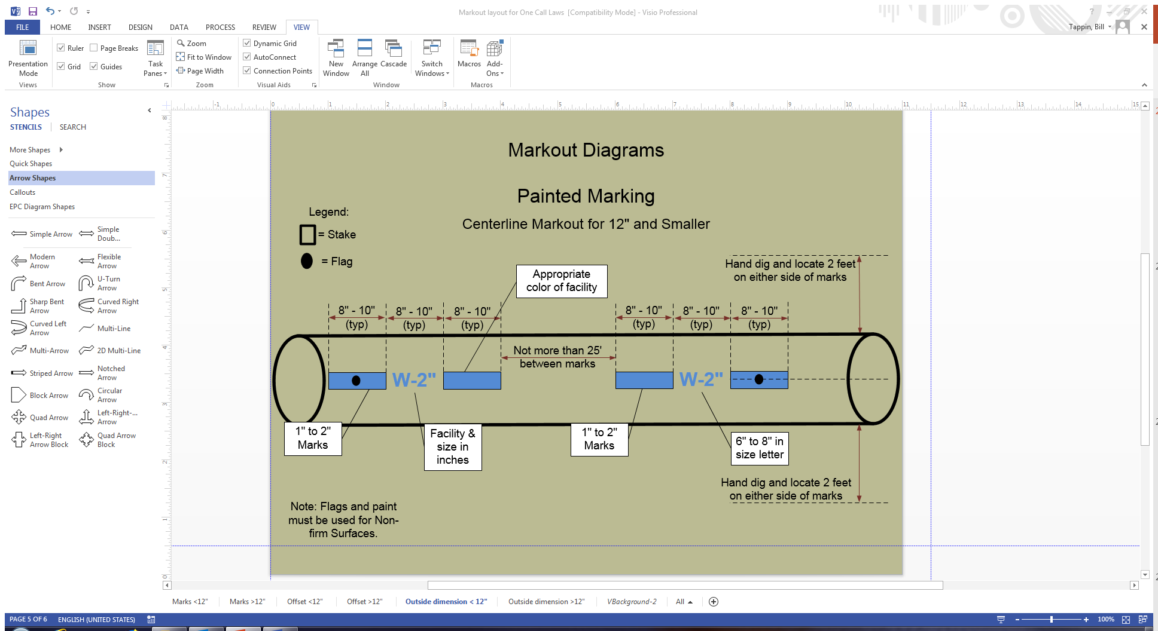

Slide 25
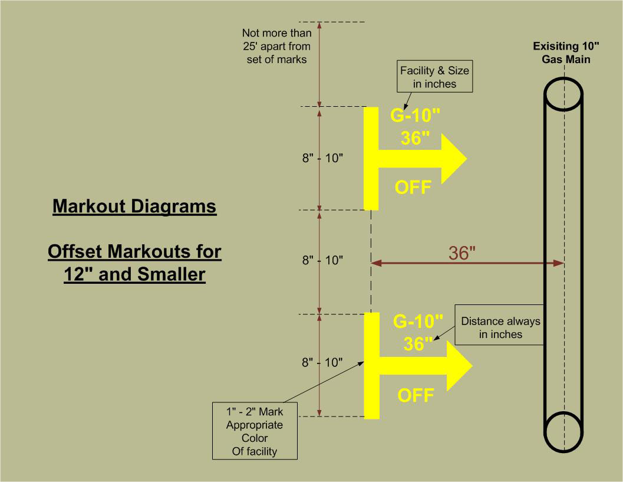

Slide 26
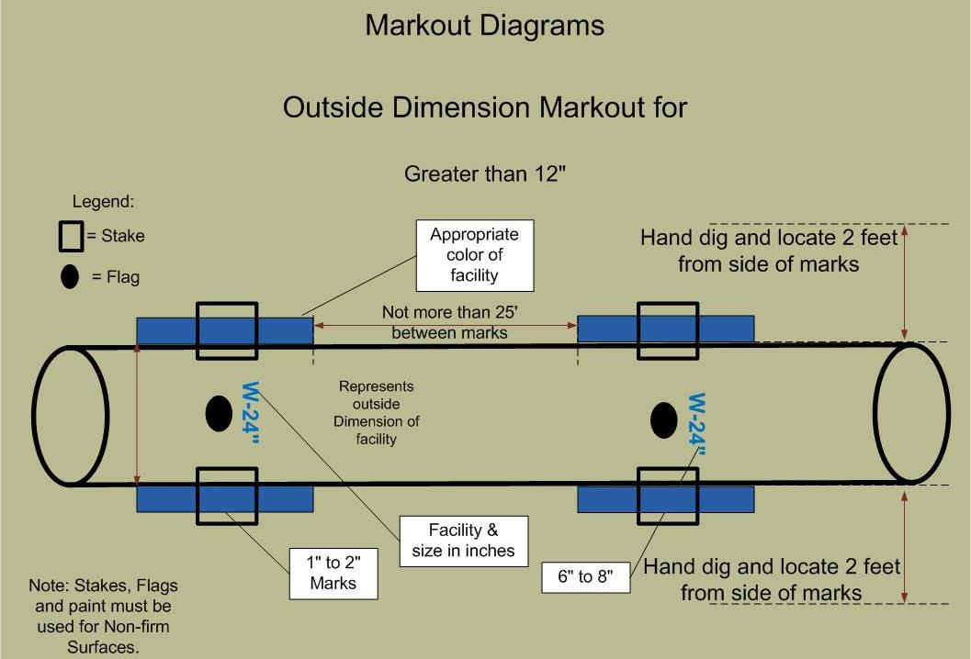

Slide 27
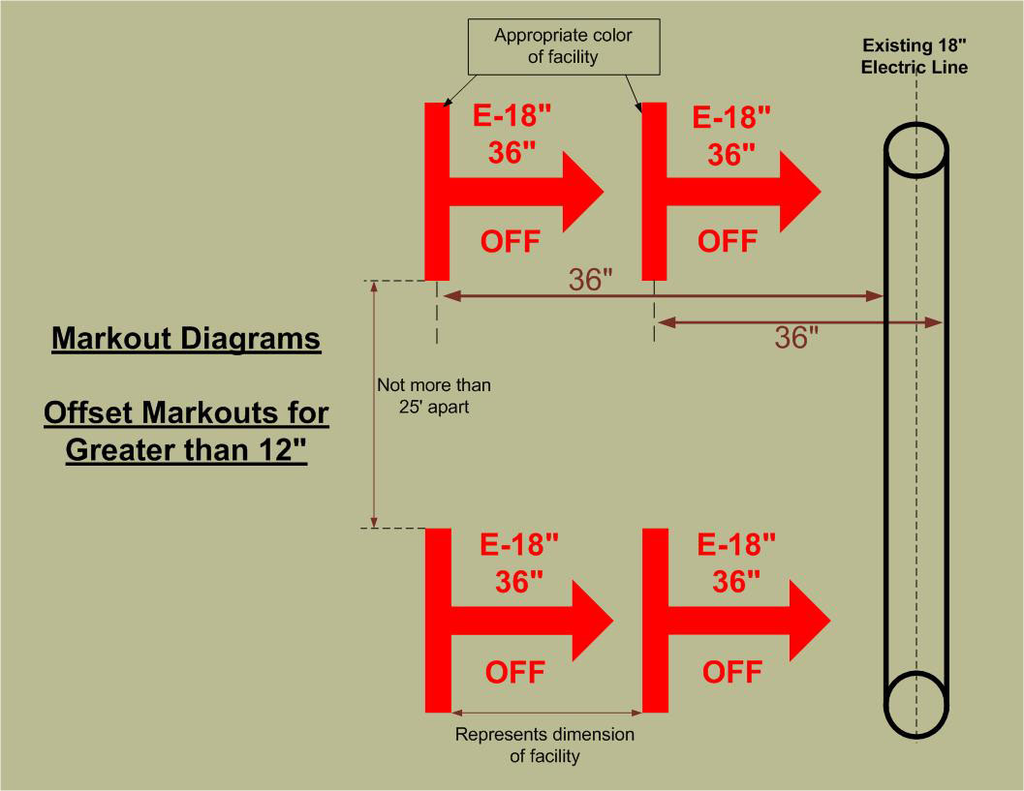

Slide 28
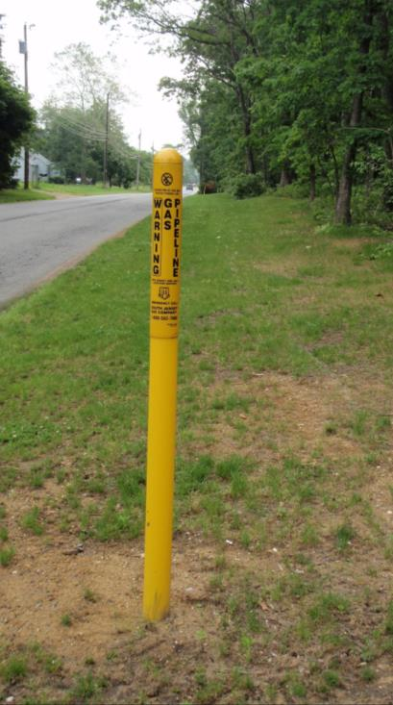
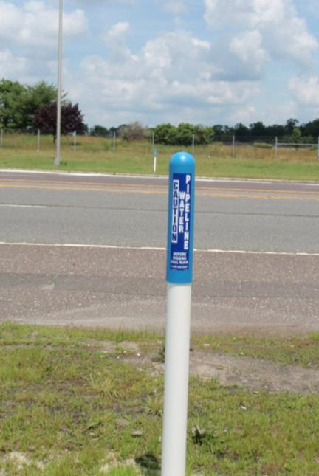
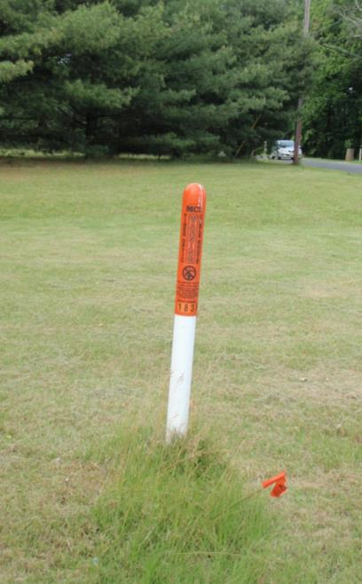
Transmission Line Markers

Slide 29
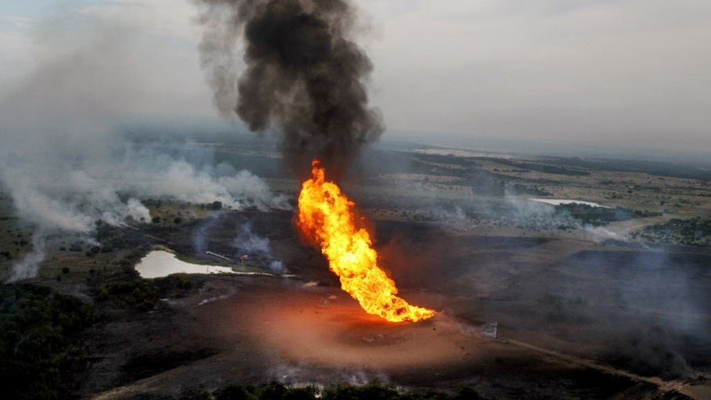
Damage to a High Pressure Gas Main
On June 7, 2010, at 2:40 p.m., a truck-mounted power auger operated by C&H Power Line Construction (C&H) struck and punctured a 36-inch-diameter natural gas transmission pipeline operated by Enterprise Products Operating, LLC (Enterprise). C&H, a contractor working for Brazos Electric (Brazos), was using the auger truck to dig holes for the installation of new electric service utility poles. The natural gas ignited and killed the auger operator and burned six workers, who were transported to a nearby hospital for treatment. The pipeline had a maximum allowable operating pressure (MAOP) of 1,051 pounds per square inch, gauge (psig) and was operating at 950 psig at the time of the accident. Total property damage and clean-up costs were estimated to be $1,029,000.
Notes:
https://www.youtube.com/watch?v=5t9bdDZavXc

Slide 30
Excavator Responsibilities to Ensure Public Safety
Take the following actions:
Hand dig within two feet of the marks to locate facilities
With open trench and during backfilling operations, facilities must be supported and protected from damage
Immediately report damages to natural gas, liquid petroleum or any hazardous liquid facilities to 911
In addition, all damages to facilities must be reported to facility operator and/or NJ1Call 811

Slide 31
CALL 911!
It’s the Law!
If a Homeowner or Excavator causes or discovers any damage to pipes carrying natural gas, liquid petroleum or any hazardous liquid:
    Call 911 and
    Report damage to underground facility operator
    Call 811 or 1-800-272-1000 the
NJ One Call Center
N.J.A.C. 14:2-3.6

Slide 32
Underground Facilities:
One Call Damage Prevention System
Underground facility operator, responsibilities; underground facility markings
N.J.S.A. 14:2-4.4 G
Each operator of an underground facility that handles natural gas or hazardous liquids shall submit a “hits report” listing any damage, emergency or One Call incident involving the operator’s natural gas or hazardous liquids facilities. The report shall be submitted to the Board by the close of business on Tuesday of the week following any two-week period in which any such damage, emergency or One Call incident has occurred.

Slide 33
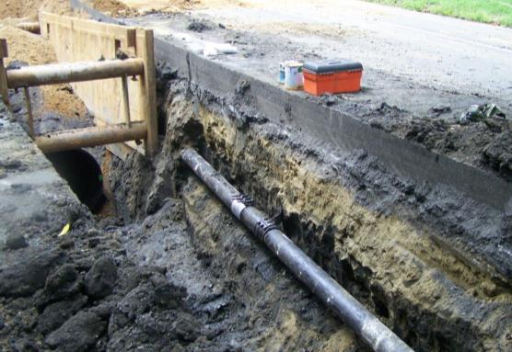
Supporting Facilities
Facilities that are exposed or in the dig
area must be supported and protected
Shoring or shielding to keep soil from
caving in or collapsing should be used
to protect the facilities
Good backfill practices and proper
compaction are required to ensure
underground facilities are not damaged as soil settles.
If underground facilities are undermined during excavation, soil above the facilities should be removed to reduce the weight on the facility.
At all times throughout the course of an excavation or demolition, an excavator shall also provide adequate physical support of all underground facilities on the site.
N.J.A.C 14:2-3.3(b)

Slide 34

Hand Digging
Excavators must hand dig and locate facilities within
24 inches of marks before operation of any mechanized equipment

Slide 35
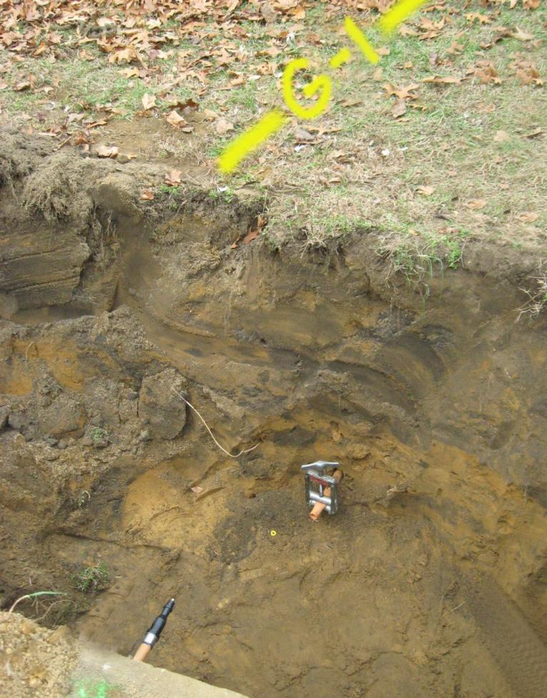
Reason for Hand Digging
Tracer Wire
Gas line
Markout paint = 0”
Hand dig with care area =24” each side of the outer wall of the facility
24” 0” 24”

Slide 36
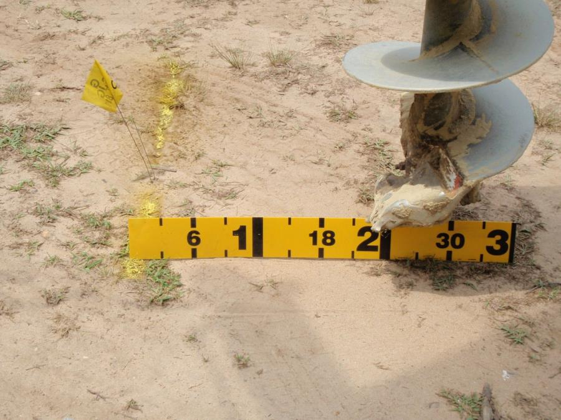
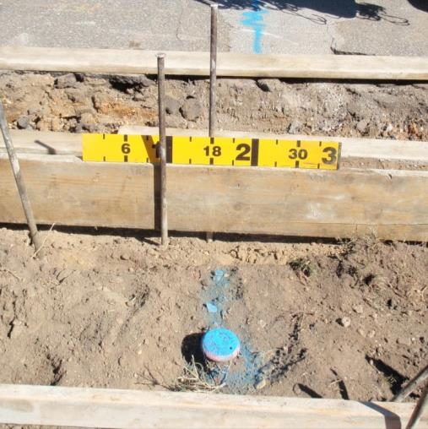
Hand Dig and Locate Within 2 Feet
Markouts are not just for backhoes. They are also needed when driving augers, pegs or stakes.

Slide 37
QUIZ!
True or False: Facilities only need to be supported in the beginning of an excavation?
  False! Facilities must be supported and protected from damage throughout the course of the excavation
True or False: Once a gas facility has been damaged, the excavator must notify the facility operator immediately.
  False! The excavator’s first call must be to 911.
True or False: It is a suggestion to hand dig and locate facilities within 24 inches of marks before operation of any mechanized equipment
  False! It is the law.

Slide 38
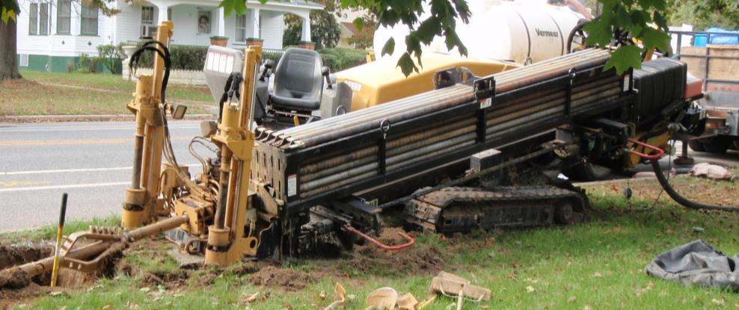
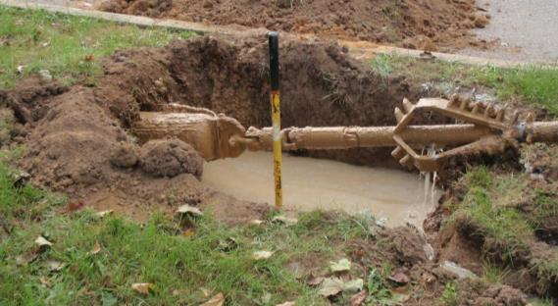
Trenchless Technology
Dig Test Holes and verify facility locations when using trenchless technology (drills, pneumatic moles, etc.)
Utilities which are being crossed must be exposed during drilling and pullback operations
When drilling parallel to a facility, test holes should be made every 25 feet or so to verify location

Slide 39
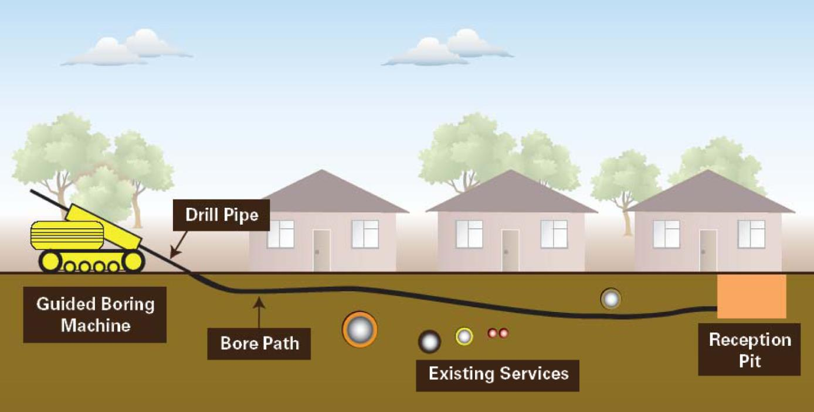
Trenchless Technology
Pot Holing Facilities

Slide 40
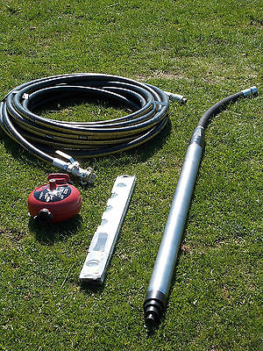
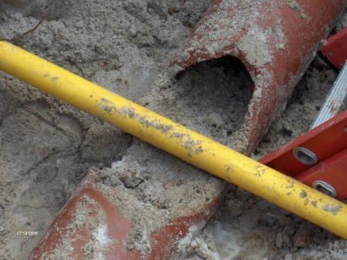
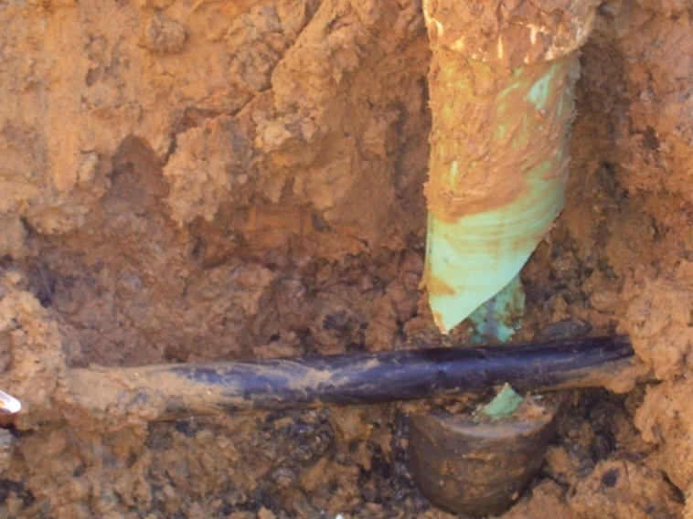
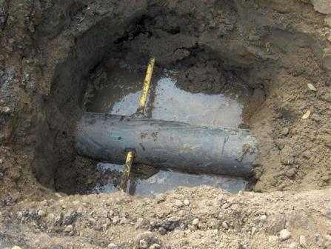
What is a Cross Bore?
The unintended installation of a utility line by trenchless construction methods which damages an existing utility.
These unintended pipe intersections might go undetected for YEARS without causing a problem.
Drill
Mole

Slide 41
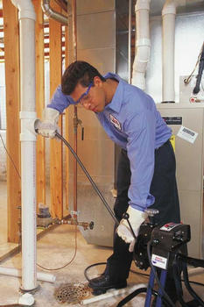
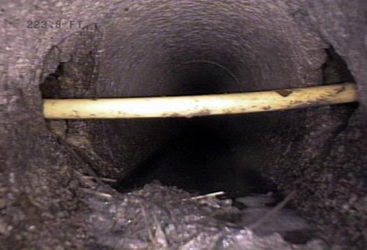
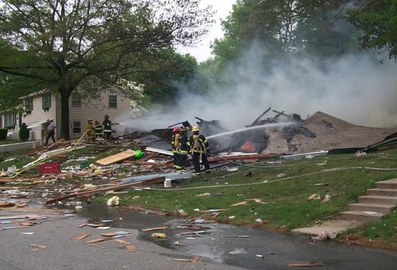
Gas Pipe Bored Through a Sewer
Can go undetected for decades
Resulting blockages can be easily mistaken for roots
Gas cross bore breach can quickly fill a house with gas (minutes)
Blockage
Possible Result
Common Fix

Slide 42

Gas Pipe Bored Through a Sewer
September 2015, Waxahachie, Texas

Slide 43
What if You Suspect a Gas Leak
Remember the three important signs to identify a potential gas leak - Look, Listen & Smell:
LOOK – for dirt blowing into the air, persistent bubbling in standing water or discolored or dead vegetation around the pipeline area.
LISTEN – for any unusual hissing or roaring sound.
SMELL – an odor that smells like rotten eggs. It’s important to note that we should not rely on our sense of smell alone to detect a leak. Odorant fade, or loss of odorant, can occur in natural gas piping.

Slide 44
What to Do if You Smell Gas
Immediately Call 911 and the local gas company
Stop work and evacuate the area
Safely shut down equipment within the
immediate area
Do not create a spark or ignition source
If the gas leak is at or near a building foundation, consider evacuating the building
Do not attempt to extinguish a natural gas fire
Do not try and fix the damaged facility

Slide 45
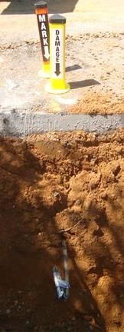
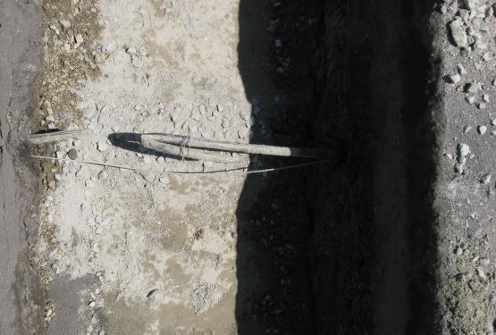
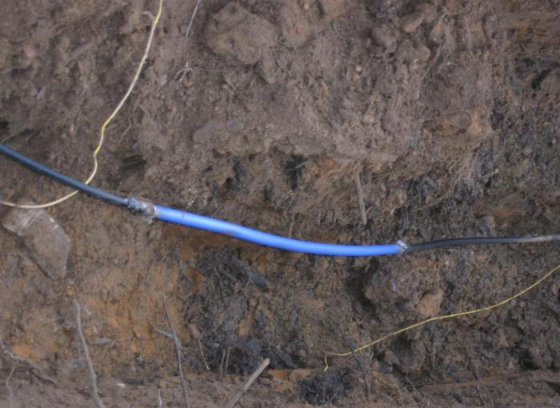
Altered and Damaged Pipe

Slide 46
Properties of Electricity
Current Flow Effect
    A 7.5 Watt lamp operating at 120 volts draws 62.5 milliamp (mA) of current flow
    Milliamp (mA) = 1/1000 Ampere
1 – 5 mA | Tingle
5 – 10 mA | Shock
10 – 50 mA | Painful Shock
OVER 50 mA | Loss of Muscle Control, Loss of Breathing, and Heart Functions, and Possible Fatal Shock

Slide 47
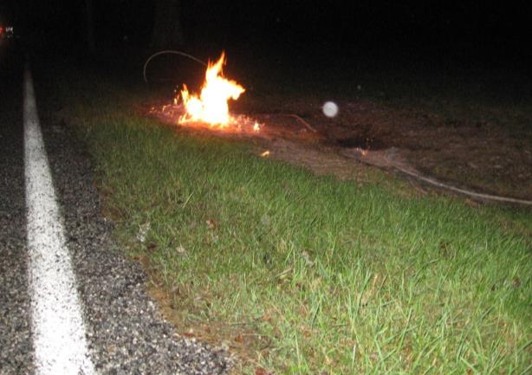
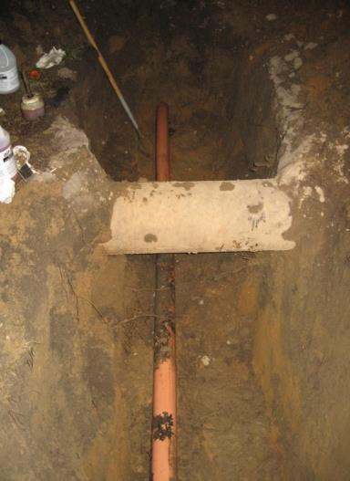
What to Do When Electric Facilities
are Exposed or Damaged
Immediately call the facility operator and NJ1Call, and stop work
Warn all persons that the ground and any object near the dig area may be energized
Excavation operator should remain on the mechanized equipment

Slide 48
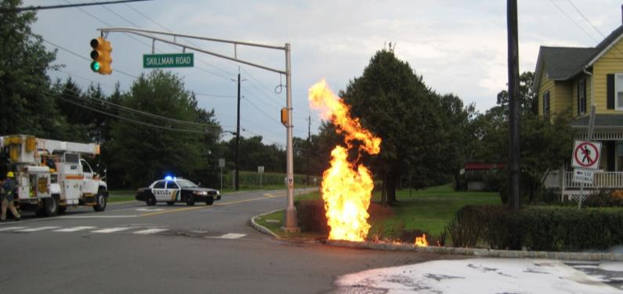
What to Do When Electric Facilities are Exposed or Damaged
Do not touch the excavating equipment, structures or materials near the point of contact
Do not resume work or evacuate excavating equipment until the facility operator has deemed the area safe
If immediate evacuation from the excavating equipment is required – jump, do not step, clear of the equipment and land on both feet
Move a safe distance
away (+25 feet) using
short hops or shuffling
steps- do not take
normal walking steps

Slide 49
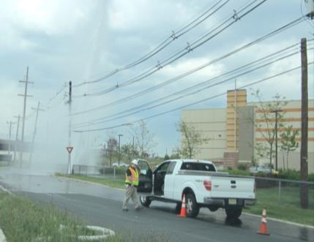
What to Do if You Damage Water or Sewer Facilities
Immediately call the facility operator and NJ One Call
Stop work and evacuate the area; leaking water can quickly fill and collapse a trench
Move carefully around trenches with wet walls
Do not operate or close valves to stop flooding
Be careful of leaking high pressure
water lines
Sewer gas is flammable; do not create
an ignition source
Avoid contact with sewer wastewater
Do not try and fix the damaged facility

Slide 50
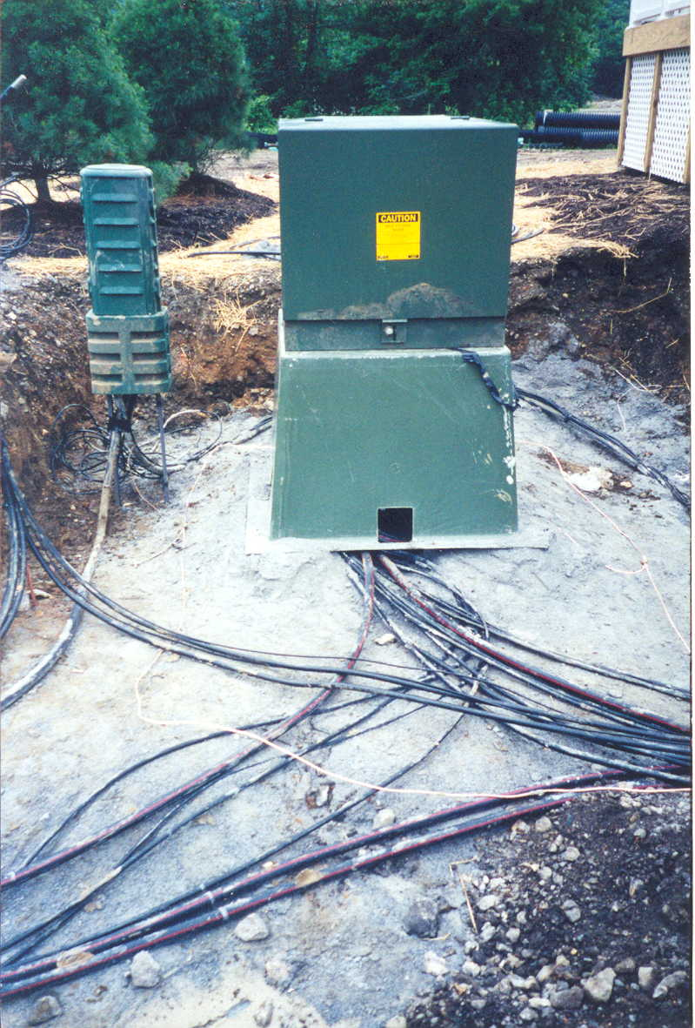
What to Do if You Damage Communication Facilities
Immediately call the facility operator and
NJ One Call 811
Stop work immediately and secure the area
Do not view or stare into broken
or severed fiber optic cables
Do not attempt to handle cables
as they may be in contact with
a power cable

Slide 51
Utility Damages –
Societal Impacts
If You Do Not Call:
Potential loss of life and property damage
(public, excavators and first responders)
Loss of service, potentially to critical facilities
Evacuation of structures
Disruption to travel (motor vehicles, buses, trains)
First Responder (costs and time)
Construction delays
You do not know what is underground, which places life, health and property at risk
You are in violation of state and federal law subject to civil and criminal penalties
You will be held 100% liable for damages and lost revenue to damaged facilities

Slide 52
QUIZ!
What is the unintended installation of a utility line by trenchless construction methods which damages an existing utility?
  Answer: A Cross Bore
What are the three ways you can detect a gas leak?
  Answer: See, Smell, Hear
True or False: Sources of ignition are safe in the presence of Sewer Gas?
  Answer: False! Sewer gas is flammable

Slide 53
CHANGES COMING YOUR WAY!
2020- Rules Changes TBD
NJ One Call Mobile App
BE ON THE LOOKOUT FOR MORE!

Slide 54
Contact New Jersey One Call Center
New Jersey One Call Center
1 Corporate Place South, Suite 150
Piscataway, NJ 08854
www.nj1-call.org
Admin Office: 732.394.3000
Admin Fax: 732.394.3007
Markout Toll Free: 811 or 800.272.1000
Email: newjersey@occinc.com

Slide 55
Links for More Information
Atlantic City Electric | www.atlanticcityelectric.com
Elizabethtown Gas | www.elizabethtowngas.com
Jersey Central Power and Light Corporation | www.firstenergycorp.com
New Jersey Natural Gas | www.njng.com
Public Service Electric and Gas | www.pseg.com
South Jersey Gas | www.southjerseygas.com
United Water New Jersey | www.unitedwater.com
New Jersey One Call Center | www.nj1-call.org
New Jersey Board of Public Utilities | www.bpu.state.nj.us
Common Ground Alliance | www.commongroundalliance.com
New Jersey Common Ground Alliance | www.njcga.com
PHMSA Pipeline Safety Program | www.phmsa.dot.gov
OSHA | www.osha.gov

Slide 56

Questions, Comments or Concerns?
It’s the Law!

